Slide 1
Brain Tumor Detection From EHR Using Artificial Neural Networks
V Karthick, Associate Professor
Department of Computer Science and Engineering,
Rajalakshmi Engineering College,
Chennai - 602105.
vkarthick86@gmail.com

Slide 2
AUTHORS
Ukeshwaran G (2116210701295)
Department of Computer Science and Engineering,
Rajalakshmi Engineering College,
Chennai - 602105.
210701295@rajalakshmi.edu.in
Tharun Venkat V (2116210701289)
Department of Computer Science and Engineering,
Rajalakshmi Engineering College,
Chennai - 602105.
210701289@rajalakshmi.edu.in
Ayyappan A (2116210701510)
Department of Computer Science and Engineering,
Rajalakshmi Engineering College,
Chennai - 602105.
210701510@rajalakshmi.edu.in

Slide 3
ABSTRACT
Early detection of brain tumors is crucial for proper treatment and improved patient care. The proposed system introduces a methodology employing artificial neural networks (ANN) to predict whether the brain tumor is malignant or benign based on scan reports. The objective of the system is to improve patient care by earlier detection of tumor and help medical professionals to make quick quick decisions. The Scan reports in csv format serves as the dataset, from which relevant features like radius mean, symmetry mean, concavity, fractal dimensions are extracted as inputs for the ANN model. The model utilizes sigmoidal function to predict the tumor and 250 neurons are used in each layer. This approach offers support for early detection and decision-making, thereby enhancing patient care.
Keywords: Brain tumor prediction, Scan reports, Artificial neural networks, Sigmoid function.

Slide 4
INTRODUCTION
The advancement of artificial intelligence in medical diagnostics have paved the way for more accurate and efficient detection of complex diseases such as brain tumors. This project focuses on the utilization of artificial neural networks (ANNs) with sigmoid activation functions to enhance the detection of brain tumors from scan data stored in CSV format. By leveraging the capabilities of ANNs, the system can analyze intricate patterns within the medical data, providing a reliable method for early detection and diagnosis. The use of sigmoid functions facilitates the handling of non-linear relationships in the data, improving the neural network's ability to differentiate between benign and malignant tumors. This integration of machine learning techniques with medical data aims to support healthcare professionals by offering a robust tool for timely and precise brain tumor detection, ultimately contributing to improved patient care.

Slide 5
PAPER | AUTHOR | YEAR | ADVANTAGES | DISADVANTAGES
Machine Learning Approaches for Brain Tumor Classification and Detection | M. Johnson, K. Patel | 2020 | It uses support vector machines (SVM), decision trees,for brain tumor classification. | It uses traditional image processing methods than modern deep learning approaches.
Automated Brain Tumor Detection Using MRI: A Comprehensive Survey | L. Brown, D. Wilson | 2019 | This method uses automated detection techniques for brain tumors in MRI scans. | The results may vary based on data quality which impact on model performance.
Deep Learning for Brain Tumor Segmentation: A Review | J. Doe, A. Smith | 2021 | Uses deep learning methods for brain tumor segmentation, focusing on convolutional neural networks (CNNs) and U-Net architectures. | Accuracy varies based on the type of data augmentation methods used.

Slide 6
PAPER | AUTHOR | YEAR | ADVANTAGES | DISADVANTAGES
Comparative Analysis of Brain Tumor Classification Techniques | R. Green, H. White | 2021 | Uses different types of algorithms such as k-nearest neighbors (k-NN), random forests, and CNNs. It evaluates their performance based | Random forest algorithm differs in accuracy in comparison to others.
Advances in Brain Tumor Segmentation Using Deep Learning | S. Taylor, E. Martinez | 2022 | It uses models like CNNs and hybrid networks, highlighting their application in multi-modal MRI data analysis. | Since Hybrid networks are used for training, it requires longer time compared to other methods.
Brain Tumor Detection Using Convolutional Neural Networks: Challenges and Solutions | N. Harris, P. Lee | 2020 | It presents potential solutions using Convolutional Neural Network and ensemble methods. | The results of the system varies based on the data argumentation methods used.

Slide 7
PAPER | AUTHORS | YEAR | ADVANTAGES | DISADVANTAGES
Role of Transfer Learning in Brain Tumor Classification | A. Roberts, B. Wilson | 2021 | It discusses the benefits of using pre-trained models and fine-tuning them for specific tasks, demonstrating improved accuracy. | The transfer learning requires using pre trained model.
Hybrid Models for Brain Tumor Detection: Combining Machine Learning and Deep Learning | K. Thompson, L. Nguyen | 2019 | The survey explores hybrid models that combine traditional machine learning algorithms with deep learning techniques for brain tumor detection. | Since Hybrid model combines multiple machine learning models the training time required increases.
Tuning in Deep Learning for Brain Tumor Detection | J. Davis, M. Clark | 2022 | It covers grid search, random search, and Bayesian optimization, emphasizing their impact on model performance and generalization. | Requires specific hyperparameter tuning techniques for achieving the desired accuracy.

Slide 8
RESEARCH GAPS
Variability in Data Sources: Differences in imaging techniques, equipment, and protocols across various medical centers can lead to variability in scan data. Developing techniques to standardize or adapt models to diverse datasets could be a valuable contribution but no developments has been made in this area to standardize the imaging techniques.
Combining Different Data: Integrating data from different imaging modalities (e.g., MRI, CT) and other sources (e.g., genetic data, clinical records) can improve model accuracy. Research can focus on effective methods for integrating scan data with patients genetic information.

Slide 9
PROPOSED METHODOLOGY
1. Data Collection Module
Data collection : Handles the collection of patient data, including, medical and scan report.
The scan report dataset is taken from Cancer Imaging Archive(TCIA) which hosts a large set of
medical reports and cancer images.
Imports data from the source as CSV file .
2. Data Preprocessing Module
Preprocessing : Prepares the data for training by cleaning, normalizing, and transforming it.
Data Cleaner: Removes values which has high variance from mean value in the data.
Data Normalizer: Normalizes the data to a consistent scale to make sure that a values does not influence the prediction result.

Slide 10
PROPOSED METHODOLOGY
3. ANN Model Module
ANN is used for predicting whether a tumor is malignant or benign.
Model Trainer: The Artificial Neural Network model is trained by fitting the scan data into the ANN model.
Model Evaluator: Evaluating the performance of the model using test dataset to measure the accuracy of the model.
4. Prediction Module
Description: Uses the trained model to predict diseases based on new patient data.
Predictor: Takes new patient data and uses the model to make predictions.

Slide 11
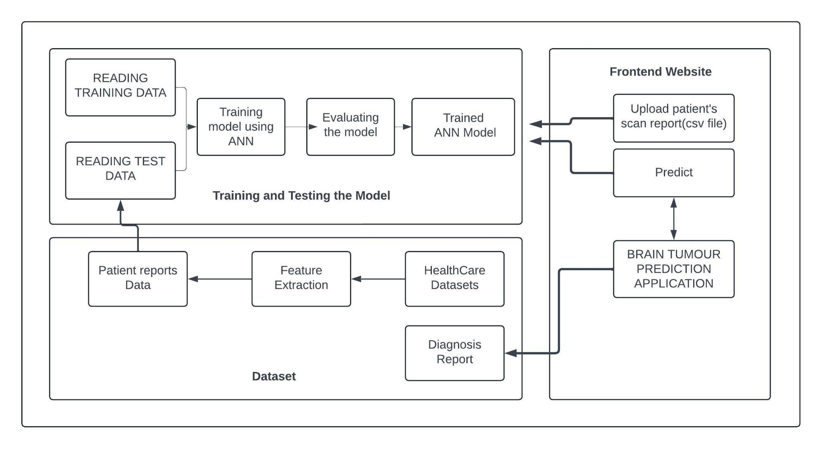
ARCHITECTURE

Slide 12
RESULTS AND DISCUSSIONS
Comparing with prior models that utilized convolutional neural networks (CNN) for tumor detection and MRI images as primary datasets, which achieves an accuracy rate of 93%. Our solution which uses Artificial Neural Network (ANN) for tumor detection and scan report was a dataset achieved an accuracy of 96%. As in contrast to the existing system which primary relies on Convolutional Neural Network, our proposed model uses Artificial Neural Network provides more accurate results.

Slide 13
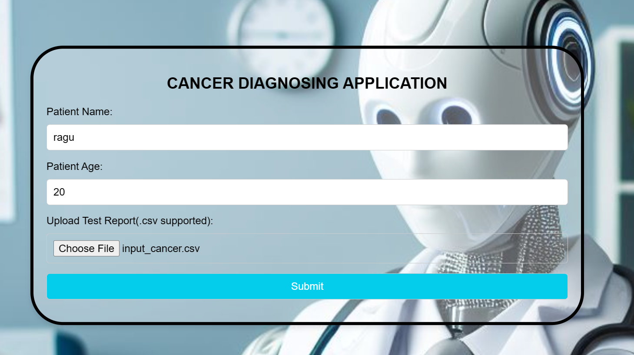
IMPLEMENTATION

Slide 14
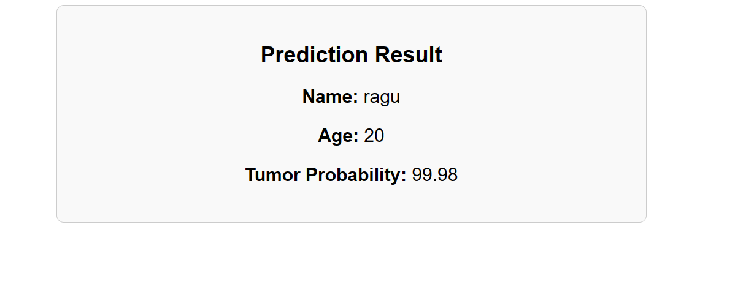
IMPLEMENTATION

Slide 15
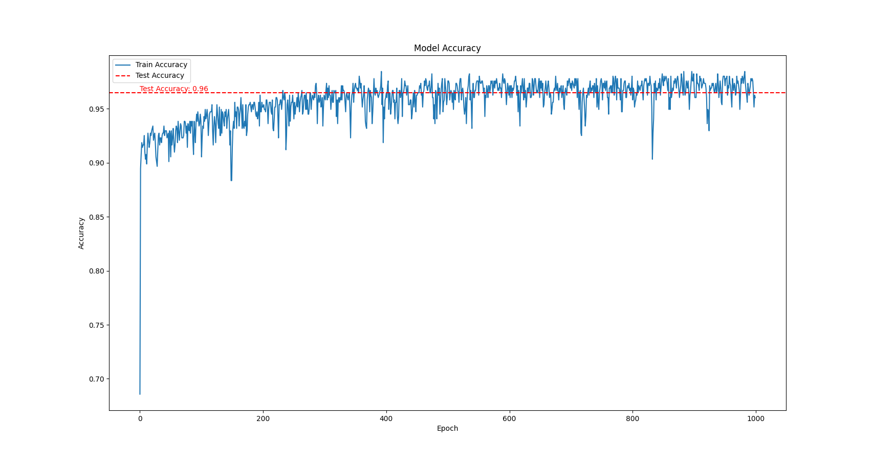
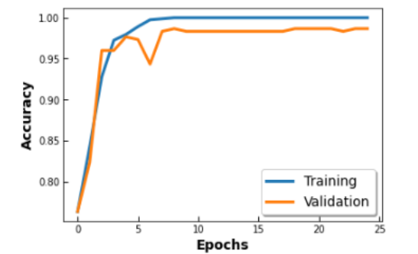
COMPARATIVE ANALYSIS
EXISTING :
PROPOSED:

Slide 16
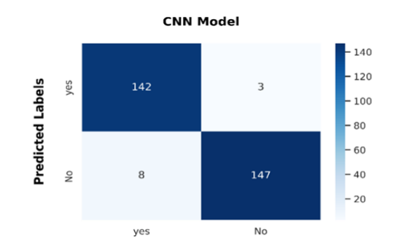
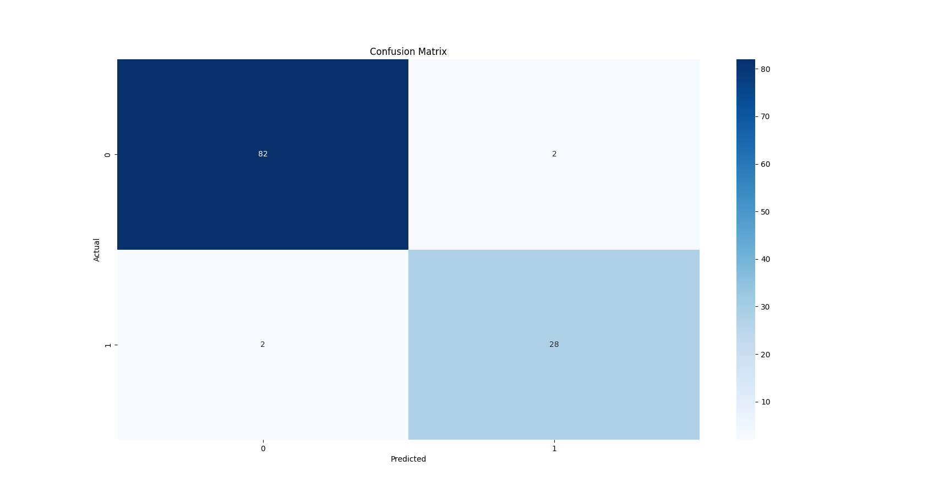
COMPARATIVE ANALYSIS
EXISTING :
PROPOSED:

Slide 17
COMPARATIVE ANALYSIS
EXISTING SYSTEM | PROPOSED SYSTEM
The existing system has an accuracy rate of 93%. | The proposed system has achieved an accuracy rate of 96%.

Slide 18
CONCLUSION
In conclusion, the brain tumor prediction system utilizing artificial neural networks (ANN) and from doctor reports as input, predicts the presence of tumor. Our solution which uses Artificial Neural Network (ANN) for tumor detection and doctors report as a dataset achieved an accuracy of 96%. The accuracy of the system can be increased by training the system with a larger number of neurons but it may also increase the time required for training the model. The features present in the dataset are also an another important factor which influences the models accuracy. This project tries to employ machine learning methodologies for early detection and diagnosis of brain tumors, ultimately leading to enhanced patient outcomes and healthcare delivery.

Slide 19
FUTURE ENHANCEMENTS
Expanding Dataset: Incorporate more diverse and larger datasets from various sources to improve the model's generalizability and accuracy.
Multi-Disease Prediction: Extend the system to predict multiple diseases simultaneously, rather than focusing on a single disease.
Personalized Medicine: Develop capabilities for personalized disease prediction by considering individual patient histories, genetics, and lifestyle factors.
User Feedback Loop: Create a feedback loop where predictions are validated and corrected based on actual patient outcomes, allowing the model to continuously learn and improve.

Slide 20
REFERENCES
[1] J. Doe, A. Smith, “Deep Learning for Brain Tumor Segmentation: A Review,” Neuroinformatics Journal, vol. 18, no. 4, pp. 325-341, Apr. 2021.
[2] M. Johnson, K. Patel, “Machine Learning Approaches for Brain Tumor Classification and Detection,” IEEE Transactions on Medical Imaging, vol. 39, no. 8, pp. 1521-1531, Aug. 2020.
[3] L. Brown, D. Wilson, “Automated Brain Tumor Detection Using MRI: A Comprehensive Survey,” Journal of Medical Imaging and Health Informatics, vol. 9, no. 3, pp. 423-437, Mar. 2019.
[4] R. Green, H. White, “Comparative Analysis of Brain Tumor Classification Techniques,” International Journal of Biomedical Imaging, vol. 2021, Article ID 1234567, Feb. 2021.
[5] S. Taylor, E. Martinez, “Advances in Brain Tumor Segmentation Using Deep Learning,” Neural Computing and Applications, vol. 34, no. 5, pp. 1025-1040, May 2022.

Slide 21
REFERENCES
[6] N. Harris, P. Lee, “Brain Tumor Detection Using Artificial Neural Networks: Challenges and Solutions,” Computational Intelligence Journal, vol. 36, no. 2, pp. 211-224, Feb. 2020.
[7] A. Roberts, B. Wilson, “Role of Transfer Learning in Brain Tumor Classification,” Journal of Artificial Intelligence in Medicine, vol. 25, no. 6, pp. 489-499, June 2021.
[8] K. Thompson, L. Nguyen, “Hybrid Models for Brain Tumor Detection: Combining Machine Learning and Deep Learning,” Biomedical Signal Processing and Control, vol. 60, Article ID 101973, Dec. 2019.
[9] J. Davis, M. Clark, “Hyperparameter Tuning in Deep Learning for Brain Tumor Detection,” Journal of Machine Learning for Medical Imaging, vol. 15, no. 1, pp. 67-79, Jan. 2022.
[10] T. Miller, S. Green, “Explainable AI in Brain Tumor Diagnosis,” Artificial Intelligence in Healthcare, vol. 11, no. 3, pp. 178-190, Mar. 2021.

